Slide 1
Unit 9 Electromagnetism
Part C: Electromagnets and Magnetic Hysteresis

Slide 2
What will we learn?
A magnetic circuit and its components.
Electromagnets and applications.
Magnetic hysteresis and how it is shaped.

Slide 3

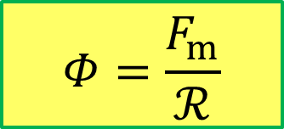
A Magnetic Circuit
The amount of flux 𝛷 depends on the mmf 𝐹_{m} and reluctance of the material ℛ.
The formula relating the three parameters is:
$$Φ=\frac{F_{m}}{ℛ}$$
Magnetic material
I
Known as Ohm’s Law for magnetic circuit
+
N
Reluctance, R
mmf
$$F_{m}=NI$$
−
I
Flux, 𝛷

Slide 4


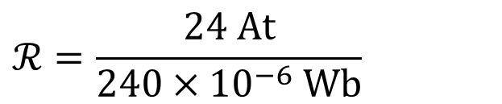

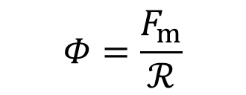
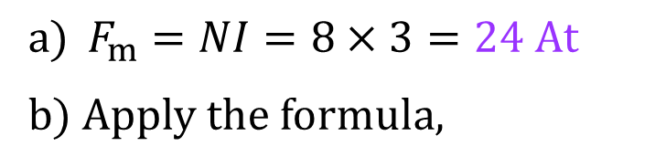
Example 1: A current of 3 A flows through a coil with 8 turns.
What is the resultant mmf?
Determine the reluctance of the flux path if the flux is 240 µWb.
$${a) F}_{m}=NI=8×3=24 At$$
b) Apply the formula,
Φ
Magnetic material
3A
$$Φ=\frac{F_{m}}{ℛ}$$
+
8 turns
$$ℛ=\frac{24 At}{240×{10}^{−6} Wb}$$
$$=100×{10}^{3}At/Wb$$

Slide 5
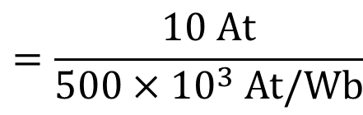

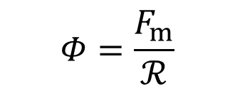

Example 2: Determine the flux established in the magnetic path if the reluctance of the material is 500 x 10³ At/Wb.
$$F_{m}=NI=5×2=10 At$$
$$Φ=\frac{F_{m}}{ℛ}$$
Φ
Magnetic material
$$=\frac{10 At}{500×{10}^{3} At/Wb}$$
2A
+
5 turns
$$=20 μWb$$

Slide 6
A Magnetic Circuit
Consider the electromagnet with an air gap between the two poles.
Nature of the magnetic field will have the flux flow across the air gap.
Reluctance of the air gap is much higher than that of the core material.
Higher mmf is required to overcome reluctance of air gap.
Easier to establish magnetic field with smaller air gap between north and south poles as reluctance is less.
I₁
I₂
S
N
S
N
air-gap
Smaller air-gap

Slide 7
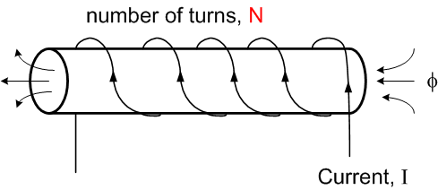
Strengthening a Magnetic Field of an Electromagnet
B can be enhanced by increasing the number of coil turns, N.
B ∝ N

Slide 8
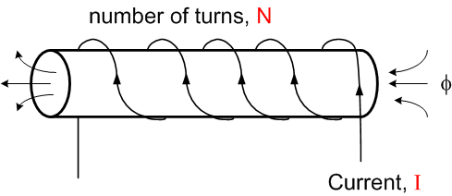
Strengthening a Magnetic Field of an Electromagnet
B can be enhanced by increasing the current in the conductor, I.
B ∝ I

Slide 9
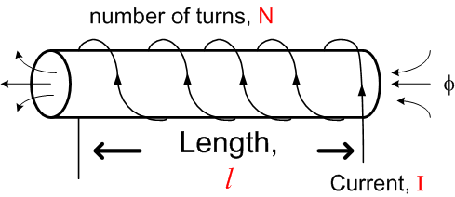

Strengthening a Magnetic Field of an Electromagnet
B can be enhanced by concentrating the coil over a shorter length, l
$$B∝\frac{1}{l}$$

Slide 10

Strengthening a Magnetic Field of an Electromagnet
B can be enhanced by using a higher permeability, µ ferromagnetic material as core
B ∝ µ
Combining all the factors:
Flux density,
µ
$$B=\frac{μNI}{l}$$

Slide 11

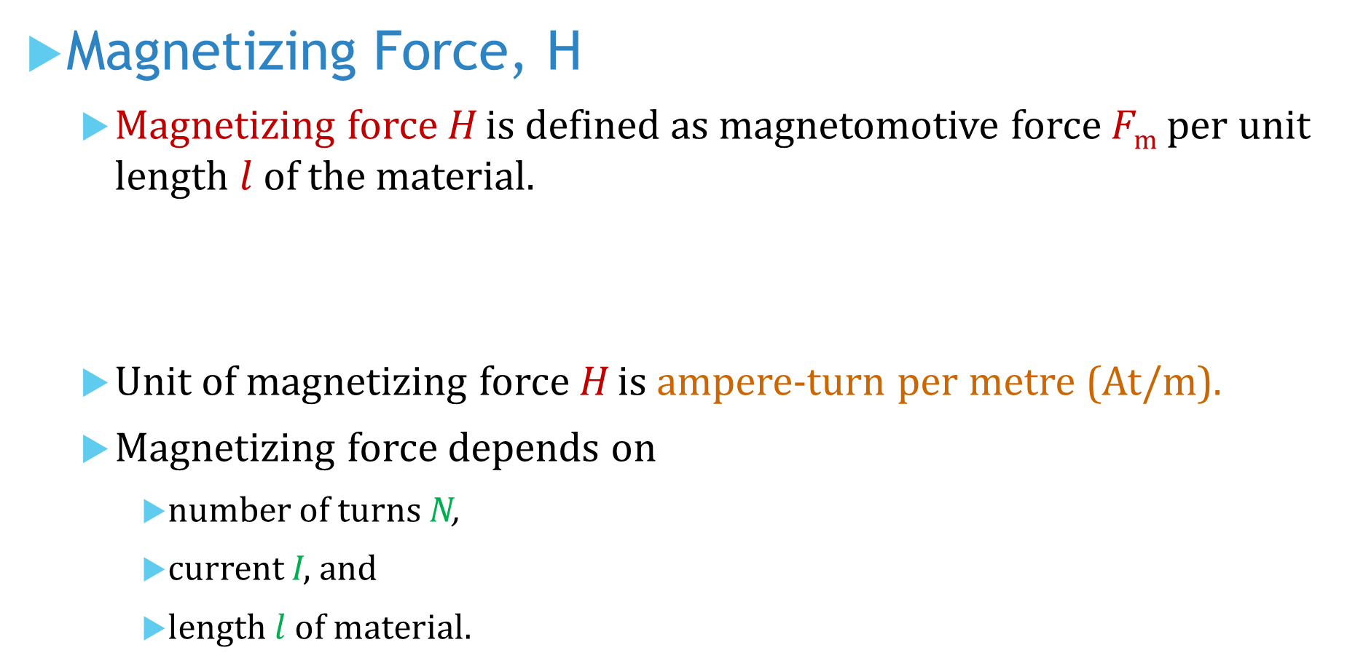
Magnetizing Force, H
Magnetizing force H is defined as magnetomotive force F_{m} per unit length $l$of the material.
Unit of magnetizing force H is ampere-turn per metre (At/m).
Magnetizing force depends on
number of turns N,
current I, and
length $l$ of material.
$$H=\frac{F_{m}}{l}$$

Slide 12




Flux Density (B) & Magnetizing Force (H)
Since
As F_{m} increases
→ flux 𝛷 increases proportionally → B increases proportionally
→ H increases proportionally
∴ B is directly proportional to H.
$$Φ=\frac{F_{m}}{ℛ}$$
$$Φ=BA$$
$$H=\frac{F_{m}}{l}$$
$$H=\frac{NI}{l}$$

Slide 13
Magnetic Hysteresis, B-H Curve
The graphic representation of the B-H relationship is called the hysteresis curve or simply B-H curve.
Hysteresis is the characteristics of a magnetic material: The change in magnetization (B) lags the application of a magnetizing force H.
The magnetizing force H can be
increased or decreased by varying current through coil of wire, and
reversed by reversing voltage polarity across coil.

Slide 14
Hysteresis Curve – Phase 1
B
B rises as H rises
Begin with unmagnetized magnetic core with B = 0.
As the magnetizing force H increases from zero, the flux density B increases proportionally.
H
B=0 initially
As H increases some more, B begins to level off.
If H continues to increase, B reaches a saturation value B_{sat} when H reaches H_{sat} .
B
Once saturation is reached, further increase in H will not increase B.
Saturation
B_{sat}
H
H_{sat}

Slide 15
Hysteresis Curve – Phase 2
If H now decreases to zero, B falls back along a different path to a residual value B_{R} .
Material continues to be magnetized even though magnetizing force H = 0.
B falls back as H reduces
This ability to maintain a magnetized state without presence of a magnetizing force is called retentivity.
B
B_{R}
Some B remains even though H=0
H

Slide 16
Hysteresis Curve – Phase 3
If current in the coil is now reversed, magnetizing force H will be negative.
Magnetic material will give up its retentivity when B decreases to 0.
Reverse current direction gives rise to negative H
The magnetizing force (−H_{C}) required to remove the retentivity and make flux density zero is called coercive force .
B
Retentivity is lost because of negative H
H
−H_{c}

Slide 17
Hysteresis Curve – Phase 4
Increasing H further in negative direction will create magnet of reverse polarity.
B
Negative B means magnet now reverses polarity
−H_{sat}
H
Saturation occurs at a value −H_{sat} where flux density is at its maximum negative value −B_{sat} .
−B_{sat}
Saturation
B increases negatively as H increases negatively until it reaches saturation

Slide 18
Hysteresis Curve – Phase 5
When magnetizing force is now removed (H = 0), flux density goes to its negative residual value −B_{R}.
B
H
H = 0
−B_{R}
Negative retentivity

Slide 19
Hysteresis Curve – Phase 6
From the −B_{R} value, flux density follows the curve indicated back until it reaches positive coercive force +H_{C} when B = 0.
B
+H_{C}
H

Slide 20
Hysteresis Curve – Phase 7
The curve continues to proceed until B reaches its maximum positive value +B_{sat} when the magnetizing force equals H_{sat} in positive direction.
B
H

Slide 21
Hysteresis Curve – A Complete Cycle
The complete hysteresis curve shows coercive force points +H_{C} and −H_{C} where flux density is zero and its retentivity points +B_{R} and −B_{R} where magnetizing force comes to zero.
B
+B_{R}
−H_{c}
H
+H_{c}
−B_{R}

Slide 22
Hysteresis Curves
Different materials exhibit different B-H characteristics
B
H

Slide 23
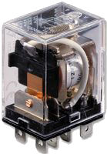
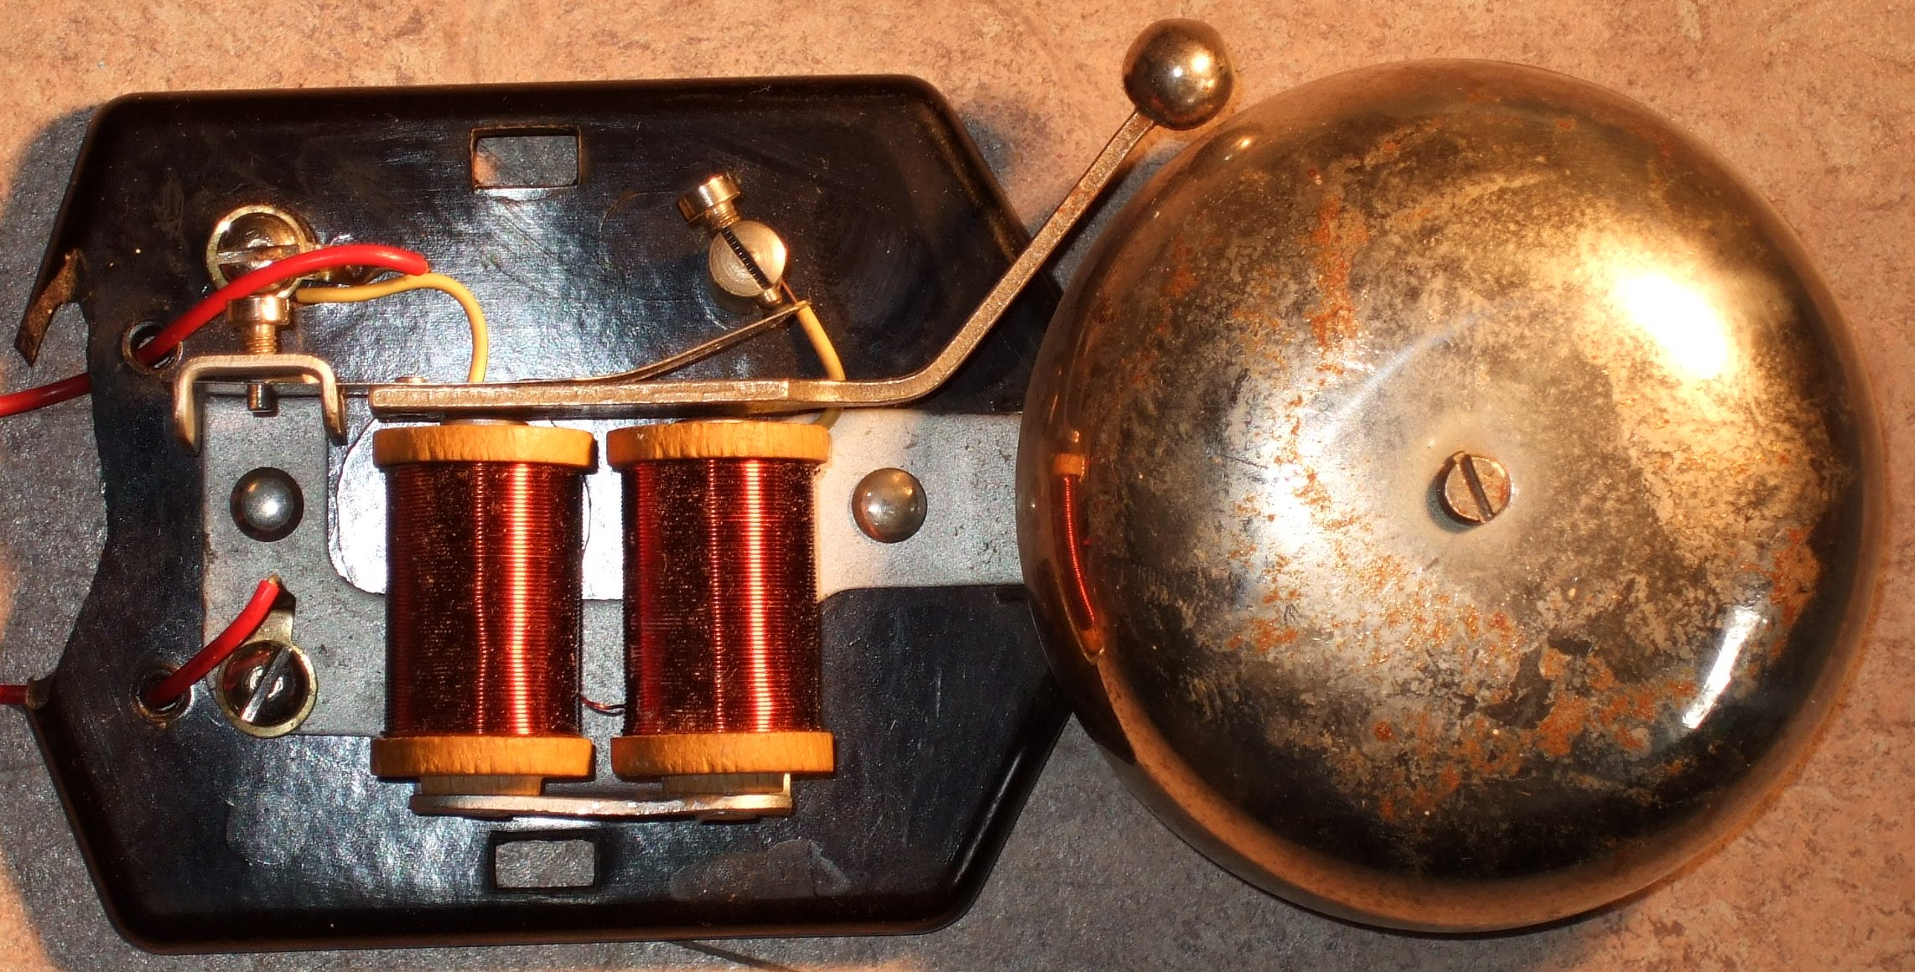
Permeability, Retentivity & Coercivity
Permeability: how ease to establish a magnetic field.
Retentivity: how well to remain magnetized without external field.
Coercivity: how difficult to be demagnetizes.
Materials with high retentivity and high coercivity are used for making permanent magnets, e.g. Neodymium and Alnico.
Materials with high permeability and low coercivity are used for making radio antennas, ferrite beads of computer cables, solenoids, electromechanical relays, door bells, circuit breakers and etc.

Slide 24
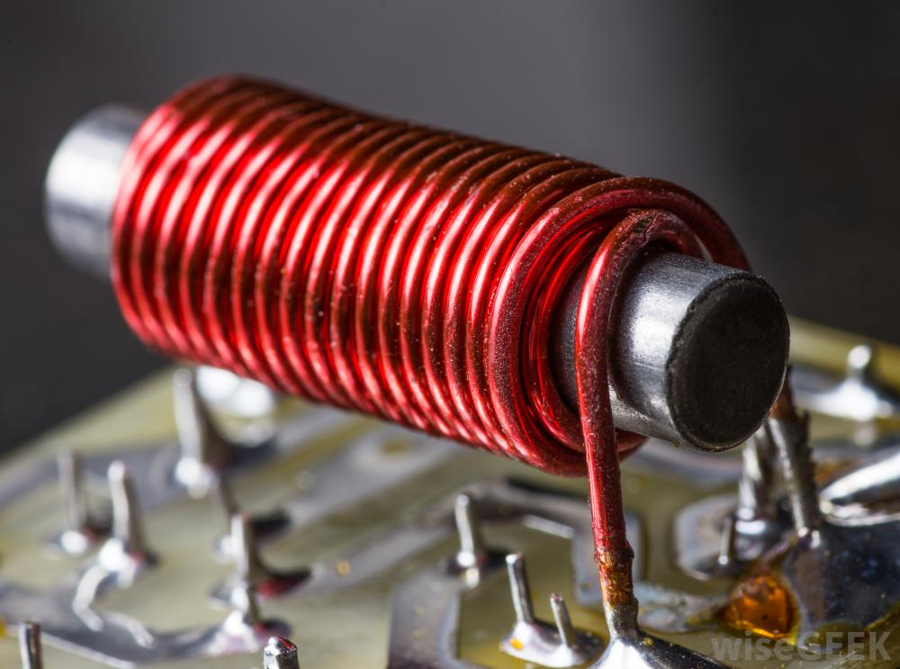
High permeability, Low Coercivity Solenoid
Made by a coil of wire wound around an easily magnetized & demagnetized core material.
When a small current flows through the coil, a magnetic field is produced around it.
The field disappears as soon as the current is turned off.
The field strength can be varied easily with the amount of current.
Its magnetic poles can be reversed by changing current direction.

Slide 25

Magnetic Strip Cards
High coercivity magnetic strip cards are more difficult to encode but less likely to be erased unintentionally. They can be use for credit cards and employee ID cards.
Low coercivity magnetic strip cards are good for short-term applications, such as single-trip magnetic train tickets.

Slide 26
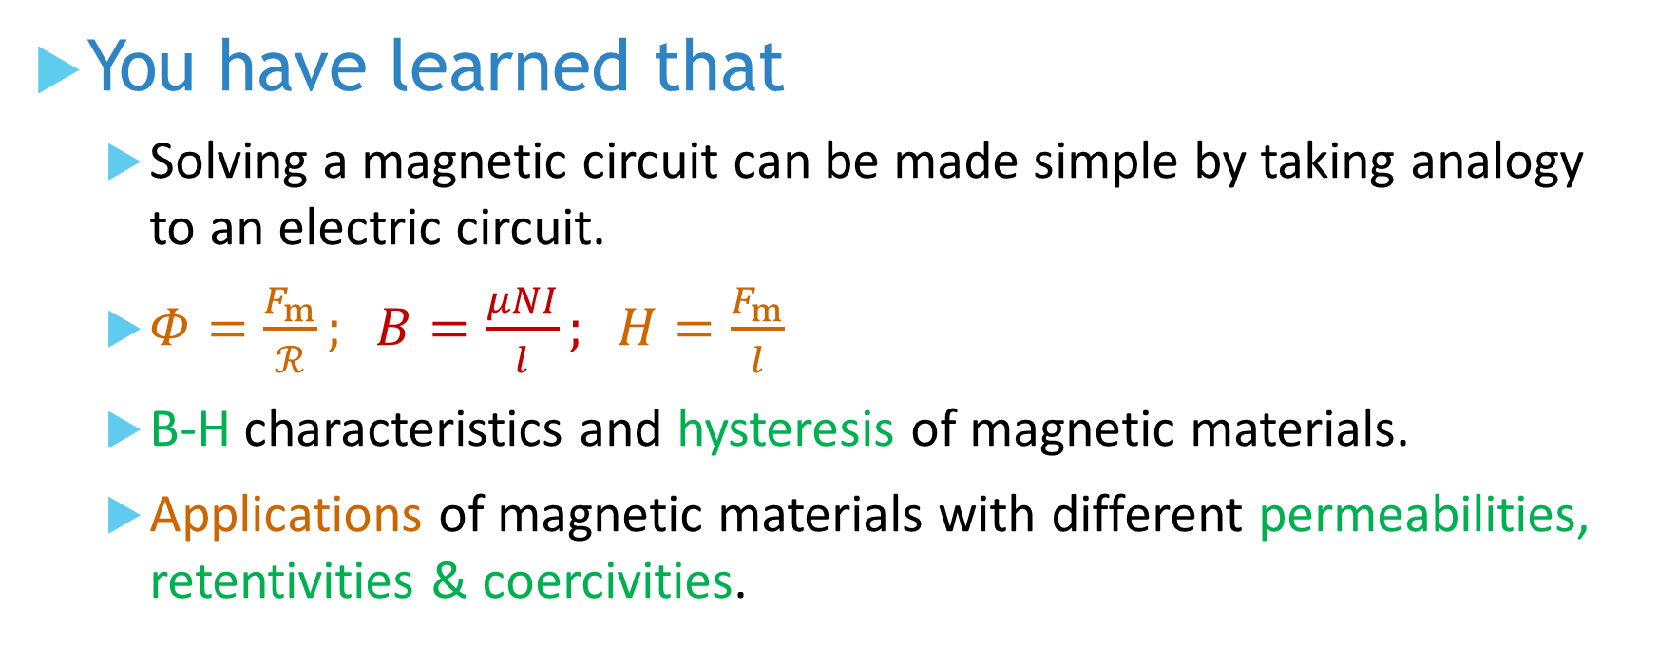
You have learned that
Solving a magnetic circuit can be made simple by taking analogy to an electric circuit.
$Φ=\frac{F_{m}}{ℛ}; B=\frac{μNI}{l}; H=\frac{F_{m}}{l}$
B-H characteristics and hysteresis of magnetic materials.
Applications of magnetic materials with different permeabilities, retentivities & coercivities.

Slide 27
Coming Up Next
Electromagnetic Induction

